Slide 1

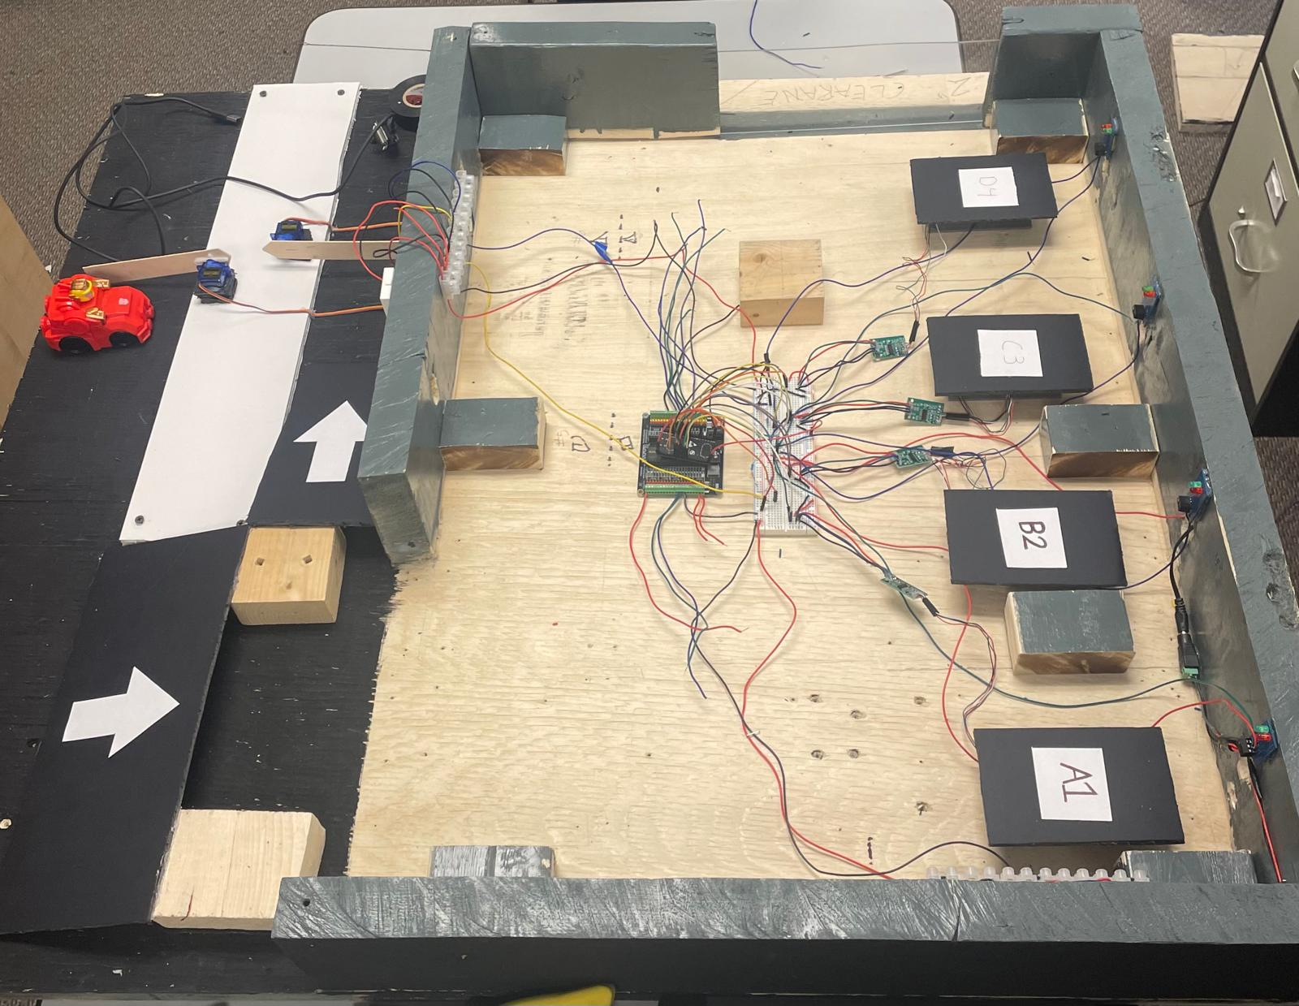
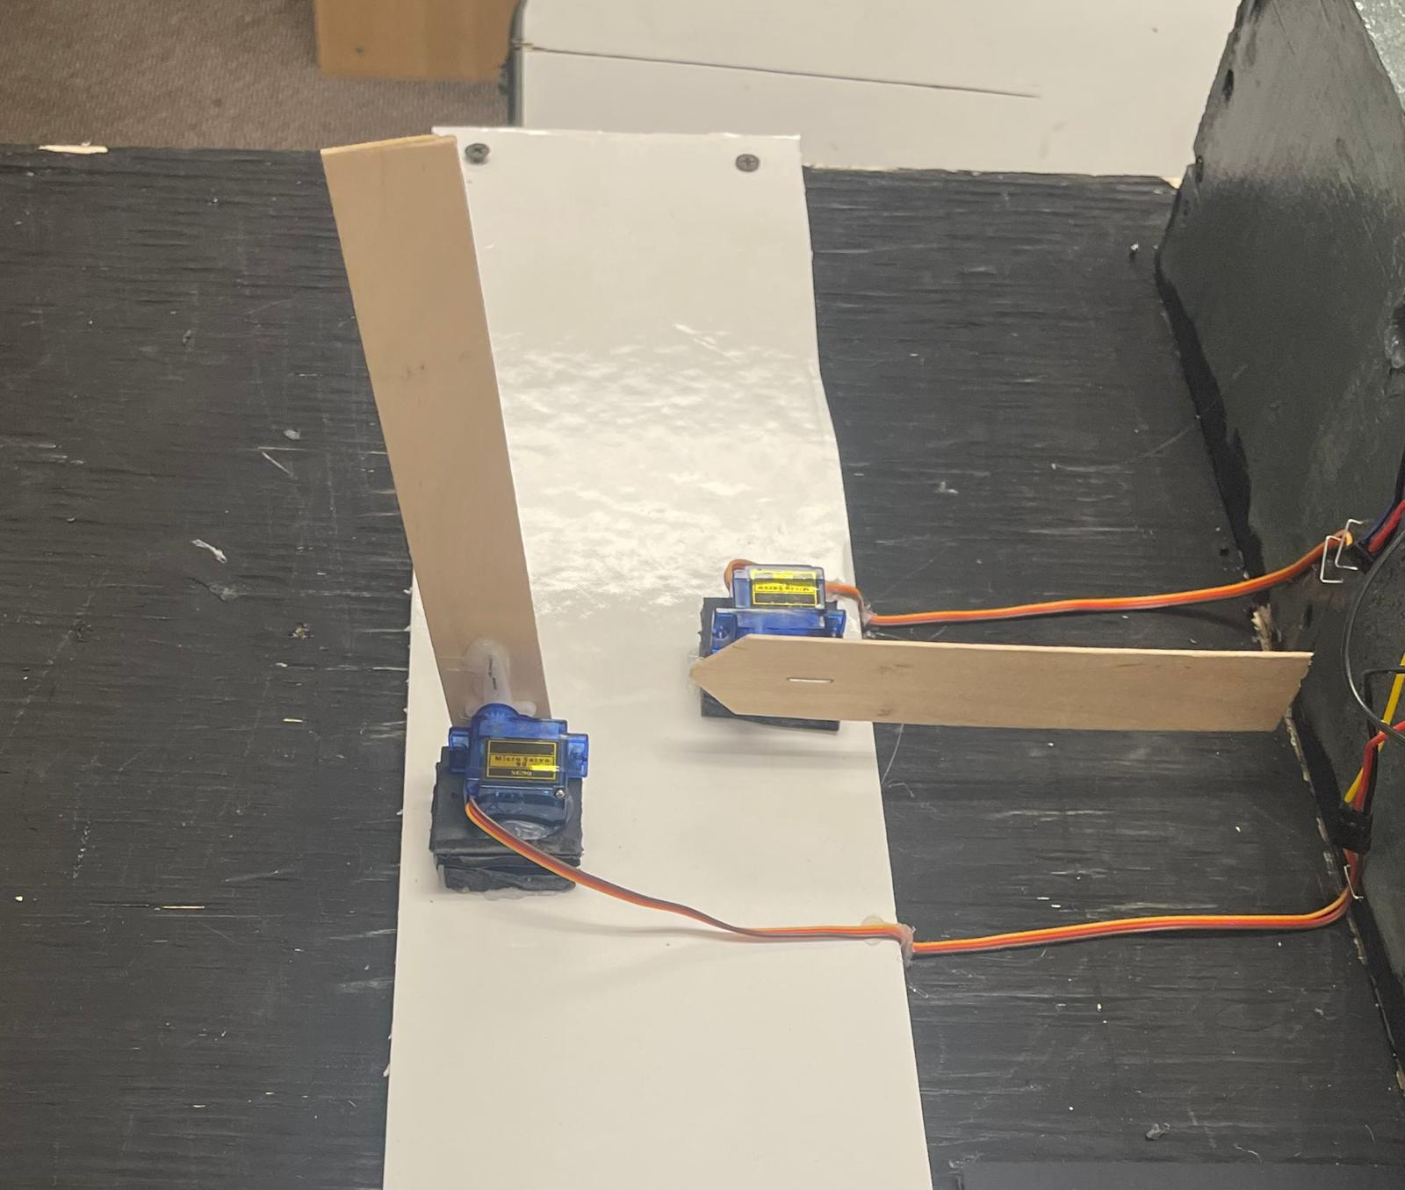
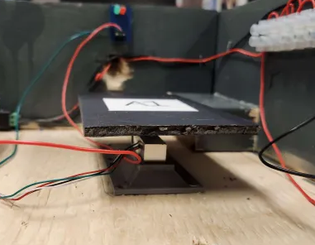
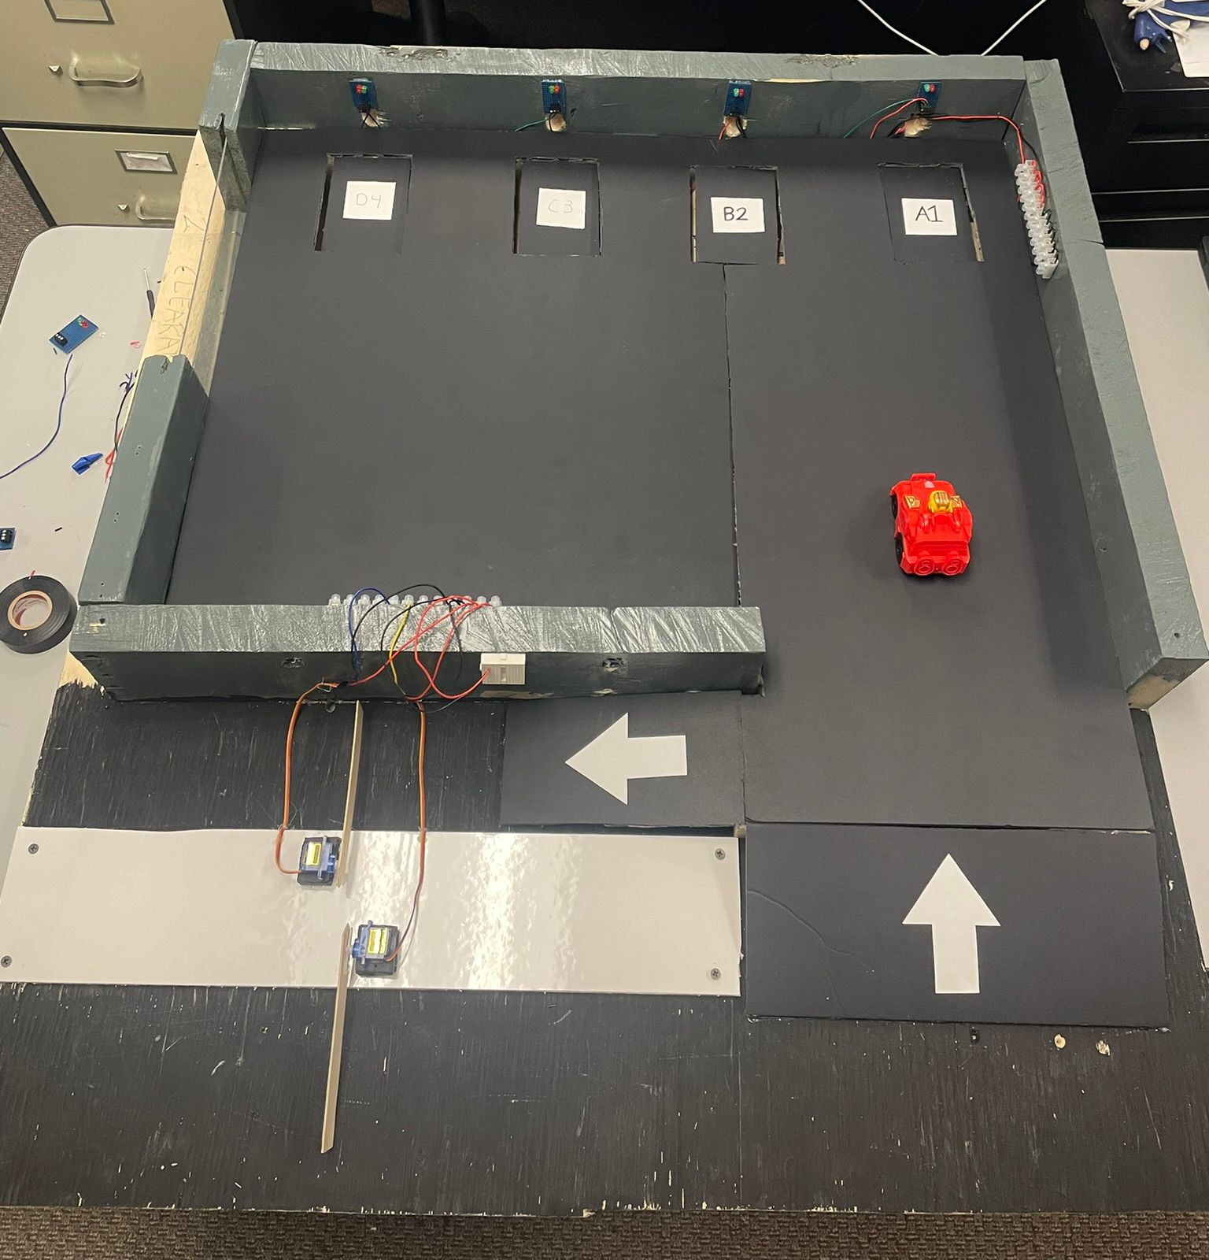
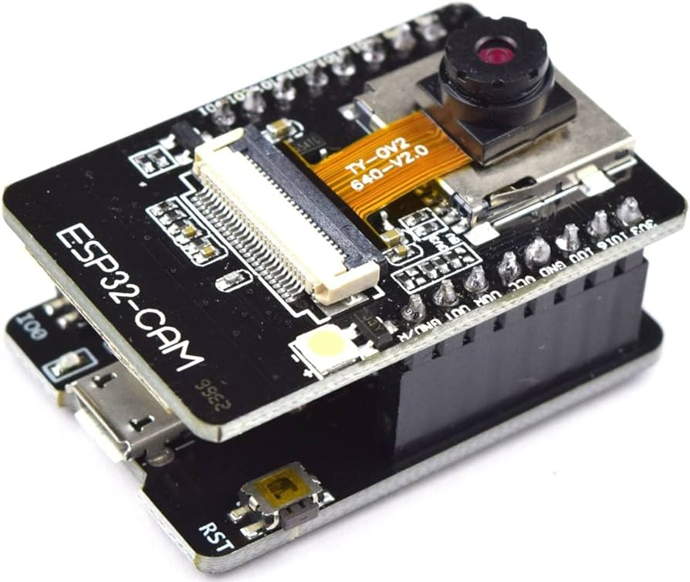
Automated Vehicle Parking Management System
Taskin Abdur-Rahman, Zohraan Badar, Kisoban Rajendran, Yadu Krishnan Madhu
Objective
The objective of this project is to design, develop, and implement an Automated Parking Management System (APMS) leveraging Internet of Things (IoT) technology to demonstrate its effectiveness in optimizing parking operations. The system will utilize sensors to detect vehicle presence in individual parking slots and collect real-time data to provide users with parking availability information via a web application. Additionally, users will have the option to pre-book parking spaces through the web application, receiving unique codes for entry and exit, enhancing security and user convenience.
Motivation
Testing
The motivation for this project stems from the escalating challenges faced by urban areas in managing limited parking spaces and increasing traffic. As cities grow more populated, the demand for efficient parking solutions is becoming increasingly urgent. Traditional parking management systems often struggle to keep pace with the dynamic nature of urban environments, leading to congestion, wasted time for drivers, and inefficient use of parking resources.
Additionally, by reducing congestion and idle times, the system can help alleviate traffic congestion, lower carbon emissions, and create a more sustainable urban environment. The implementation of smart features such as pre-booking and QR code access enhances security and convenience for users, further incentivizing the adoption of the system.
Testing QR Code Scanning and Gate Opening;
The functionality of scanning QR codes and opening gates was tested together as a combined unit. This testing phase focused on checking if the ESP32 cameras could accurately capture and decode user generated QR codes. Following this the gate opening mechanism underwent testing to ensure it properly responded to authenticated QR codes allowing authorized vehicles to enter and exit the parking area.
Validation of Weight Sensors and Traffic Light Integration; This test aimed to confirm the precision of weight sensor readings in detecting vehicle presence and triggering traffic light changes from green to red upon a parking spot being occupied. The seamless coordination between weight sensors and traffic lights was crucial for facilitating traffic flow within the parking premises.
Evaluation of Web Application Functionality;
The web application underwent testing to assess its features and user interface, including evaluating functionalities like real time updates on parking availability, pre booking options and user authentication processes.
Comprehensive System Testing;
After verifying components the APMS was integrated as a complete system, for comprehensive testing.
Approach
The implementation of the APMS followed a structured approach encompassing hardware integration, software development, and rigorous testing. The systems structure included weight sensors to detect parking lot occupancy and ESP32 cameras for verifying QR codes at entry points. To create a user web application that provides real time parking availability information and allows for pre booking, React, JavaScript and HTML were used. Additionally C++ programming was employed to code the microcontrollers that communicate with the hardware components to ensure data transmission and processing.
Conclusion
In summary our implementation of the Automated Parking Management System (APMS) signifies a progress, in managing parking efficiently. By utilizing technologies like weight sensors and ESP32 cameras we have improved parking operations and enriched the user experience through a user friendly web-app. The development of a user web application simplifies interactions offering features like booking options and QR code verification. Thorough testing and integration guarantee the systems functionality, dependability and scalability. In essence our research showcases how APMS has the potential to transform parking systems contributing to more sustainable cities, in the coming years.
Figure 3:Servo Motors(Gates)
Figure 1: Skeleton Parking Lot Fixture
Figure 4:Weight Sensor and Platform
References and Acknowledgements
We would like to thank,
Dr. Alagan Anpalagan: The Faculty Lab Coordinator (FLC) for this project, who is recognized for his guidance and assistance for students throughout their design project.
ECB Department: The Department of Electrical, Computer, and Biomedical Engineering for facilitating the capstone design project experience for students and for their continued support for the learning opportunities available for students.
Figure 2: Completed Parking Lot Fixture
Figure 5: ESP32 Camera(QR Code Detection)
Notes:
‹#›

